Slide 1
Green IT Metrics And Measurements
Presented By:
Shubham, Rahul & Atharva

Slide 2
Metrics and Measurements
Metrics is a standard of measurements.
Green IT metrics provide data that can be used in support of a formal business case for green transformations.
Metrics are the means to ascertaining whether a green program has actually fulfilled a policy goal.
Green metrics can measure not only the reduction in the carbon emissions per process but also the lean-ness of the business

Slide 3
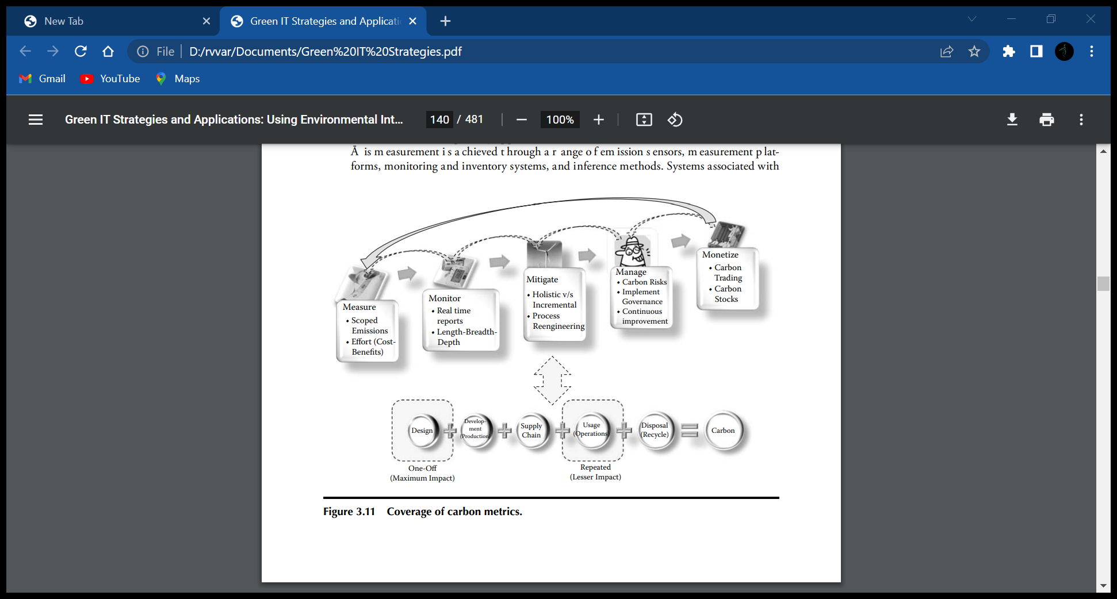
Carbon Metrics Coverage
Measure
Monitor
Manage
Mitigate
Monetize

Slide 4
Green IT Measurement Challenges
Having discussed the Green IT metrics and measurements, it is also important to identify and deal with the challenges organizations are likely to face in implementing them in practice.
Following are the specific challenges and issues relating to the use of Green IT metrics and measurements within organizations:

Slide 5
Challenges:-
Lack of formal metrics and associated measurements related to carbon performance of an organization.
Lack of availability of real-time data and corresponding defined metrics to calculate carbon performance
Difference in calculations of carbon emission based on electricity consumed from different source
Assumptions

Slide 6
Measuring Carbon Footprint of an Organization
Dynamic Measures
The dynamic measure are the measure of energy consumed during the day-to-day operation of the organization.
The dynamic measures change on a daily basis, and are made up of the emissions of the organization in its production line, service processes, and also include the impact of attitude and behavior of the people working within the organization.
The dynamic measure is an ongoing measure that needs to be computed over a specific period of time(e.g. one month, one year) to ascertain the emissions of the organization

Slide 7
Static Measures
The static measures are a group of measures that are ascertained based on the procurement, design and also the disposal aspect of materials and equipment's in the organization
These measures also include the buildings, infrastructures, and all such procurements that are one-off, usually undertaken of the start of a project within the organization and do not change during the course of the usage.
For example, the carbon emission associated with the construction of a data center from occur only once at the start of the data center.

Slide 8
THANK YOU

